Slide 1
Trusted SLA-Guided Data Integration on Multi-cloud Environments
Project funded by ARC 6
Daniel A S Carvalho, Magellan, IAE, Univ. J. Moulin Lyon 3, France
Chirine Ghedira-Guegan, Magellan, IAE, Univ. J. Moulin Lyon 3, France
Nadia Benani, LIRIS-CNRS, INSA-Lyon, Univ. Lyon, France
Genoveva Vargas-Solar, CRNS, LIG-LAFMIA, France

Slide 2
Agenda
Context and Challenges
Work done in the 1st year: systematic mapping
Ongoing work: query rewriting algorithm
Conclusions and Future works
Notes:
The agenda of my presentation...

Slide 3
Context and Challenges
Data integration x Cloud computing
Classical data integration scenario
Query
Result
Mediator
Data source A
Data source B
Data source C

Slide 4
Quality oriented data integration
Query
Result
(Quality preferences)
Mediator
Data provider A
SLA
Data provider B
SLA
Data provider C
SLA
Notes:
Now we can see a new scenario for data integration... where we have different data providers A, B and C geographically disposed on different clouds. In the cloud scenario quality aspects are defined and agreed between the service provider and the service customer through contracts.
Service level agreements (SLA) is an example of these contracts.
As in the classical scenario we have a query that must be answered and this query is submitted to a mediator who will rewrtite it in accordance with the different data providers and the result will be integrated to be sent back to the user.
In this scenario we have some limitations and challenges such as:
* we have different SLAs schemas exported by the providers
* we have different level of SLAs... such as SLAs between the user and the data provider, SLA between the data provider and the cloud, and also SLAs between different data providers..
* we have different measures in different SLAs which have the same meaning
considering this new scenario, the use of SLA on data integration approaches is an open challenge and we believe that the quality on this approaches can be enhanced

Slide 5
Quality oriented data integration
Query
Result
Which services should I select? Are the requirements being respected?
(Quality preferences)
How to be sure that all SLAs are being respected?
Mediator
How to integrate different SLAs associated to services with user’s preferences?
How results can be reused for a next query?
In this new scenario, we believe that the quality on data integration could be enhanced by using SLA contracts
Data provider A
SLA
Data provider B
SLA
Data provider C
SLA
Notes:
Now we can see a new scenario for data integration... where we have different data providers A, B and C geographically disposed on different clouds. In the cloud scenario quality aspects are defined and agreed between the service provider and the service customer through contracts.
Service level agreements (SLA) is an example of these contracts.
As in the classical scenario we have a query that must be answered and this query is submitted to a mediator who will rewrtite it in accordance with the different data providers and the result will be integrated to be sent back to the user.
In this scenario we have some limitations and challenges such as:
* we have different SLAs schemas exported by the providers
* we have different level of SLAs... such as SLAs between the user and the data provider, SLA between the data provider and the cloud, and also SLAs between different data providers..
* we have different measures in different SLAs which have the same meaning
considering this new scenario, the use of SLA on data integration approaches is an open challenge and we believe that the quality on this approaches can be enhanced

Slide 6
Objective
The objective is to propose a data integration solution in a multi-cloud environment guided by user preferences and SLA exported by different clouds.

Slide 7
Work done in the 1st year: systematic mapping
Categorize and quantify the key contributions and the evolution of the research done on SLA-guided data integration in a multi-cloud environment
Discover open issues and limitations of existing works

Slide 8
SM Process
Definition of research question
Conduct search
Papers screening
Keywording using abstracts
Data extraction and mapping process
Review scope
All papers
Research papers
Classification scheme
Systematic map
Notes:
The process consists in five steps, from the definition of resarch questions to the generation of quantitative vision of the state of the art. Each phase produces a concrete result that will eventually help to perform an analytic study and a state of the art of the field.
I will describe briefly each phase and show concretely what we did in our work.

Slide 9
Mapping results
Notes:
Recall the first research question intended to identify the SLA measures that have been mostly applied in the cloud
Therefore we combined three categories of our proposed classification scheme the one concerning quality measures, data integration description and data integration environment. Aggregating papers dealing with these categories, whe observed that click
Privacy
SLA

Slide 10
Mapping results
Notes:
Finally, research question number three explored in which way and context has data integration been used with QoS measures
Three categories were coupled again: Data integration environment, data integration description and Measures, since Quality can be considered both while describing data integration strategies and within specific architectures. Concretely the cloud and multi – cloud are the architectures that most consider QoS … but in fact few papers address both aspects, and some issues seem still open.

Slide 11
Mapping results
Notes:
The objective of the second research question was to observe the evolution of publication trends towards the cloud, and how it was related to SLA issues. We observed that
SLA publications emerged when
The # of publications

Slide 12
Mapping results
Notes:
Other interesting observations were analyzed by combining the data integration Environments, with the type of contributions and research developed. The analysis shos that
The cloud is …
Of course the paper referes and argues about other observations and combinations of categories that lead to have a quite interesting picture of works addressing data integration, in multi-cloud conditions and that integrate SLA or some QoS measures to it. Due to time let us rather try to give elements to answer the initial question:

Slide 13
Lessons & Contribution
Trends and open issues on SLA guided multi-cloud data integration show that
Quality understood by the user and the cloud provider must be integrated under the same vision, in this case the SLA’s
SLA assessment must be integrated within the whole data integration process
Data integration classification scheme that
characterizes a:
modern vision of data integration in multi-cloud environments
enhanced by including SLAs in its process
is supported by the analysis of the literature considering the most popular paper databases and applying the SM method
Notes:
Trends and ....
So the contribution of this paper is a data integration classification scheme that:
-characterizes a:
Is supported by ...

Slide 14
Ongoing work: query rewriting algorithm
Rhone service-based query rewriting algorithm
Problem addressed: given a set of abstract services, a set of concrete services, a user query and a set of quality preferences
Derive a set of service compositions that answer the query and fulfil the quality requirements.

Slide 15
Rhone service-based query rewriting algorithm
Our related works are in two domains:
Query rewriting algorithms in the database domain (answering query using views)
Query rewriting algorithms in service composition domain:

Slide 16
Rhone service-based query rewriting algorithm
References: Query rewriting algorithms in the database domain:
Levy A.Y., Rajaraman A., Ordille J.J. Querying heterogeneous information sources using source descriptions. In: VLDB, pp. 251–262, 1996
Duschka O.M., Genesereth M.R. Answering recursive queries using views. In: PODS, pp. 109–116, 1997
Prasenjit Mitra. An Algorithm for Answering Queries Efficiently Using Views. Stanford University Technical Report. In Proceedings of the Australasian Database Conference, Jan 2001.
Rachel Pottinger and Alon Halevy. MiniCon: A scalable algorithm for answering queries using views. The VLDB Journal 10, 2-3 (September 2001), 182-198, 2001.
Chen Li. Rewriting Queries using Views. Encyclopedia of Database Systems 2009: 2438-2441.
George Konstantinidis and José Luis Ambite. Optimizing query rewriting for multiple queries. In Proceedings of the Ninth International Workshop on Information Integration on the Web (IIWeb '12). ACM, New York, NY, USA, , Article 7 , 6 pages, 2012.
References: Query rewriting algorithms in the service composition domain
Linhua Zhou and Huajun Chen and Yu Tong and Jun Ma and Zhaohui Wu. Ontology-based Scientific Data Service Composition: A Query Rewriting-based Approach. 2008.
M. Barhamgi, D. Benslimane, and B. Medjahed. A query rewriting approach for web service composition. Services Computing, IEEE Transactions on, 3(3):206-222, July 2010.
Zhao, W., Liu, C., and Chen, J. Automatic composition of information-providing web services based on query rewriting. Science China Information Sciences, pages 1–17, 2011.
Mesmoudi, A., Mrissa, M., and Hacid, M.-S. (2011). Combining configuration and query rewriting for web service composition. In ICWS, pages 113–120.
Paiva Tizzo, N.; Coello, J.M.A.; Cardozo, E., "Improving dynamic Web service selection in WS-BPEL using SPARQL," in Systems, Man, and Cybernetics (SMC), 2011 IEEE International Conference on , vol., no., pp.864-871, 9-12 Oct. 2011
Oulmakhzoune, S.; Cuppens-Boulahia, N.; Cuppens, F.; Morucci, S., "Privacy Policy Preferences Enforced by SPARQL Query Rewriting," in Availability, Reliability and Security (ARES), 2012 Seventh International Conference on , vol., no., pp.335-342, 20-24 Aug. 2012
Umberto S. Costa, Mirian Halfeld Ferrari, Martin A. Musicante, and Sophie Robert. Automatic refinement of service compositions. In Florian Daniel, Peter Dolog, and Qing Li, editors, Web Engineering, volume 7977 of Lecture Notes in Computer Science, pages 400-407. Springer Berlin Heidelberg, 2013.
Our related works are in two domains:
Query rewriting algorithms in the database domain (answering query using views)
Query rewriting algorithms in service composition domain:

Slide 17
Rhone service-based query rewriting algorithm
Originality:
The user can express her quality preferences and associate them to her queries
Service’s quality aspects are defined on Service Level Agreements (SLA) guide service selection and the whole rewriting process

Slide 18
Rhone service-based query rewriting algorithm
Steps:
Select candidate concrete services
Create mappings from concrete services to the query (Concrete service description - CSD)
Combine CSDs
Produce rewritings

Slide 19
Rhone service-based query rewriting algorithm (Formalization)
Input data: (1) a query; and (2) a list of concrete services
Definition 1 (Query):
Q(I, O) := A₁(I, O), A₂(I, O), .., A_{n}(I, O), C₁, C₂, .., C_{m}[P₁, P₂, .., P_{k}]
C and P are in the form: name operation value
<, >, ≤, ≥, ≠ and =

Slide 20
Rhone service-based query rewriting algorithm (Formalization)
Example:
Single measure: availability, price per call, price per request, response time, location, provenance, etc.
Composite measure: total price or cost which are computed by adding price per call and price per request values of all services included in the service composition. Total response time is computed by adding the response time of all services included in the service composition.
Quality Preferences P (or measures) can be:
Single measure: static measure associated to the service
Composed measure: dynamically computed measures associated to a rewriting. It is based on aggregations of single measures

Slide 21
Rhone service-based query rewriting algorithm (Formalization)
Abstract Services Available
Abstract Service | Description
DiseaseInfectedPatient (d?, p!) | Given a disease d, it retrieves patients p
DiseaseInfectedPatient (d?, p!, op!) | Given a disease d, it retrieves patients p, and op is an optional boolean output indicating if the operation proceeded well or not.
PatientDNA (p?, dna!) | Given a patient p, it retrieves DNA dna
PatientPersonalInformation (p?, info!) | Given a patient p, it retrieves patient’s personal information info
Considering that we have the following pre-defined abstract services:

Slide 22
Rhone service-based query rewriting algorithm (Formalization)
The user wants to retrieve patient’s personal and DNA information who were infected by a disease «K» using services that have availability higher than 98%, price per call less than 0.2 dollars, and total cost less then 1 dollar.
Q(disease?, patientInfo!, dna!) := DiseaseInfectedPatient (d?, p!), PatientPersonalInformation (p?, info!), PatientDNA (p?, dna!) [availability > 98, price per call < 0.2, total cost < 1]

Slide 23
Rhone service-based query rewriting algorithm (Formalization)
Definition 2 (Concrete services):
S(I, O) := A₁(I, O), A₂(I, O), .., A_{n}(I, O) [P₁, P₂, .., P_{k}]
P are in the form: name operation value
P represents the SLA exported by the concrete service
S do not have composed measures

Slide 24
Rhone service-based query rewriting algorithm (Formalization)
S1(a?,b!) = DiseaseInfectedPatient (a?,b!) [availability > 98]
S2(a?,b!) = DiseaseInfectedPatient (a?,b!) [availability > 98, price per call = 0.2]
S3(a?,b!) = DiseaseInfectedPatient (a?,b!) [availability > 98, price per call = 0.1]
S4(a?,b!) = PatientPersonalInformation (a?,b!) [availability > 98, price per call = 0.1]
S5(a?,b!) = PatientDNA (a?,b!) [availability > 99, price per call = 0.1, location = “close”]
S5(a?,b!) = DiseaseInfectedPatient (a?,c!), PatientPersonalInformation (c?,b!) [availability > 99, price per call = 0.1]
S5(a?,b!,c!) = DiseaseInfectedPatient (a?,p!), PatientPersonalInformation (p?,b!), PatientDNA (p?,c!) [availability > 99, price per call = 0.1]
According to the example, let us suppose the following concrete services:

Slide 25
Rhone service-based query rewriting algorithm (Formalization)
Definition 3 (measures matching):
All single measures in the query must exist in the concrete service, and all of them can not violate the measures in the query.
Definition 4 (abstract service matching):
An abstract service A can be matched with an abstract service B only if
(a) they have the same name; and
(b) they have a compatible number and type of variables

Slide 26
Rhone service-based query rewriting algorithm (Formalization)
References: web service selection and composition considering QoS aspects
Valeria Cardellini, Emiliano Casalicchio, Vincenzo Grassi and Francesco Lo Presti. Scalable Service Selection for Web Service Composition Supporting Differentiated QoS Classes. Technical Report RR-07.59, Dip. di Informatica, Sistemi e Produzione, Università de Roma Tor Vergata, 2007.
Alrifai, M., Risse, T., Dolog, P., and Nejdl, W. (2008). A scalable approach for qos-based web service selection. In ICSOC Workshops, pages 190–199.
Alrifai, M., Skoutas, D., and Risse, T. (2010). Selecting skyline services for qos-based web service composition. In WWW, pages 11–20.
Karim Benouaret, Djamal Benslimane, Allel Hadjali, and Mahmoud Barhamgi. FuDoCS: A Web Service Composition System Based on Fuzzy Dominance for Preference Query answering, September 2011. VLDB - 37th International Conference on Very Large Data Bases - Demo Paper.
Benouaret, K.; Benslimane, D.; Hadjali, A., "Selecting Skyline Web Services for Multiple Users Preferences," in Web Services (ICWS), 2012 IEEE 19th International Conference on , vol., no., pp.635-636, 24-29 June 2012
Cheikh Ba, Umberto Costa, Mirian Halfeld Ferrari, Rémy Ferre, Martin A. Musicante, Veronika Peralta, and Sophie Robert. Preference-Driven Refinement of Service Compositions. In CLOSER (4th International Conference on Cloud Computing and Services Science), Proceedings of CLOSER 2014, page 8 pages, Barcelona, Spain, April 2014. POSTER presentation.
Definition 5 (concrete service matching):
A concrete service can be matched with the query if all its abstract services satisfy the abstract service matching problem and all the single measures satisfy the measures matching problem.

Slide 27
Rhone service-based query rewriting algorithm (Formalization)
S1(a?,b!) = DiseaseInfectedPatient (a?,b!) [availability > 98]
S2(a?,b!) = DiseaseInfectedPatient (a?,b!) [availability > 98, price per call = 0.2]
S3(a?,b!) = DiseaseInfectedPatient (a?,b!) [availability > 98, price per call = 0.1]
S4(a?,b!) = PatientPersonalInformation (a?,b!) [availability > 98, price per call = 0.1]
S5(a?,b!) = PatientDNA (a?,b!) [availability > 99, price per call = 0.1, location = “close”]
S5(a?,b!) = DiseaseInfectedPatient (a?,c!), PatientPersonalInformation (c?,b!) [availability > 99, price per call = 0.1]
S5(a?,b!,c!) = DiseaseInfectedPatient (a?,p!), PatientPersonalInformation (p?,b!), PatientDNA (p?,c!) [availability > 99, price per call = 0.7]
Considering our concrete services in the example;

Slide 28
Rhone service-based query rewriting algorithm (Formalization)
Definition 6 (concrete service description):
Describes how a candidate concrete service can be used in the query rewriting process.
It includes:
Mappings from variables in a concrete service to variables in the query
Mappings from variables on the head of a concrete service to variables on its body
A set of abstract services that represents partially or fully the abstract services in the query
A set of quality constrains associated to the concrete service.

Slide 29
Rhone service-based query rewriting algorithm (Formalization)
Definition 6 (concrete service description):
A CSD is represented by an n-tuple:
‹S, h, ϕ, G, P›
S is a concrete service.
h are mappings between variables in the head of S to variables in the body of S.
ϕ are mapping between variables in the concrete service to variables in the query.
G is a set of abstract services covered by S.
P is a set quality constraints associated to the service S.

Slide 30
Rhone service-based query rewriting algorithm (Formalization)
Definition 6 (concrete service description):
Rule 1: head and local variables in the concrete service can be mapped to head variables in the query if they are from the same type
Rule 2: local variable in the concrete service can be mapped to a local variable in the query if: (i) they are from the same type; and (ii) the concrete service cover all abstract service in the query that depends on this variable. “Depends” here means that this local variable is used as input in another abstract service.
Q(a?,b!,c!) := S1(a?,b!) S2(p?,c!)

Slide 31
Rhone service-based query rewriting algorithm (Formalization)
S3(a?,b!) = DiseaseInfectedPatient (a?,b!) [availability > 98, price per call = 0.1]
S4(a?,b!) = PatientPersonalInformation (a?,b!) [availability > 98, price per call = 0.1]
S5(a?,b!) = PatientDNA (a?,b!) [availability > 99, price per call = 0.1, location = “close”]
S5(a?,b!) = DiseaseInfectedPatient (a?,c!), PatientPersonalInformation (c?,b!) [availability > 99, price per call = 0.1]
S5(a?,b!,c!) = DiseaseInfectedPatient (a?,p!), PatientPersonalInformation (p?,b!), PatientDNA (p?,c!) [availability > 99, price per call = 0.7]
Considering our example:

Slide 32
Rhone service-based query rewriting algorithm (Formalization)
S3(a?,b!) = DiseaseInfectedPatient (a?,b!) [availability > 98, price per call = 0.1]
S4(a?,b!) = PatientPersonalInformation (a?,b!) [availability > 98, price per call = 0.1]
S5(a?,b!) = PatientDNA (a?,b!) [availability > 99, price per call = 0.1, location = “close”]
S5(a?,b!,c!) = DiseaseInfectedPatient (a?,p!), PatientPersonalInformation (p?,b!), PatientDNA (p?,c!) [availability > 99, price per call = 0.7]
Definition 7 (valid rewriting):
A valid rewriting is a set of CSDs that:
Entirely covers the query
There is no CSD in duplicity
There are mappings for all variables
Rewritings:
Q(disease?, patientInfo!, dna!) = S3 (disease?,p!) S4 (p?, patientInfo!) S5 (p?,dna!)
Q(disease?, patientInfo!, dna!) = S5 (disease?, patientInfo!, dna!)

Slide 33
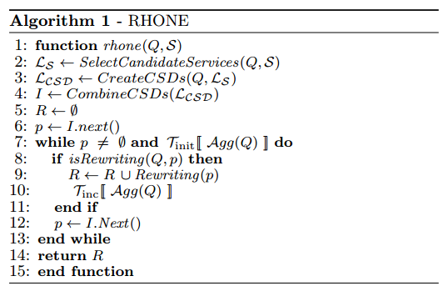
Rhone service-based query rewriting algorithm
Rewritings:
Q(disease?, patientInfo!, dna!) = S3 (disease?,p!) S4 (p?, patientInfo!) S5 (p?,dna!)
Q(disease?, patientInfo!, dna!) = S5 (disease?, patientInfo!, dna!)

Slide 34
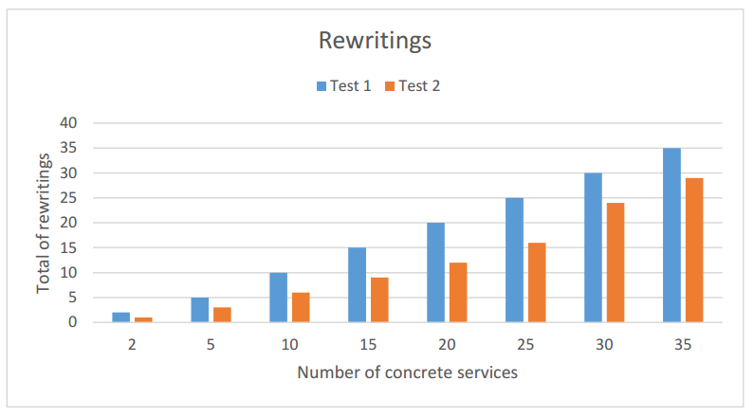
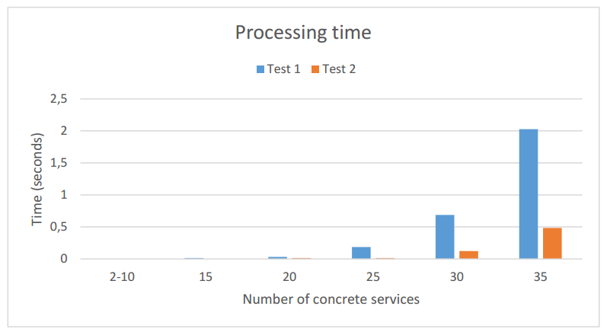
Preliminary results

Slide 35
Conclusions and Future works
The idea regarding my thesis project
Context and challenges
The work done during the 1st year
Systematic mapping and Article
The ongoing work concerning the algorithm
Improving the algorithm and producing experiments
Cost model for query rewriting

Slide 36
Thank you for your attention!
Questions? Opinions?
They are welcome! ☺

